Slide 1
MONTGOMERY COUNTY, md:
COUNTING OUR TOWS
Elizabeth Click, DATA205
Montgomery College
May 10, 2021

Slide 2
content
Data Ingestion
Data Wrangling
Exploratory Data Analysis
Statistical Analysis
Map Visualization
Recommendations

Slide 3
DATA INGESTION
“TRESSPASS TOWING REPORT”
Source: Data Montgomery <API> 'https://data.montgomerycountymd.gov/api/views/i6vn-3s6e/rows.csv?accessType=DOWNLOAD'
Description: Vehicular Towing in the County as reported to Police Department, updated monthly

Slide 4
Data ingestion
B. “American Community Survey”, estimate for 2019
Source: 'https://api.census.gov/data/2019/acs/acs5?key=MY_API_KEY&get=NAME,B29004_001E,B01003_001E,B02001_003E&for=block%20group:*&in=state:24&in=county:031&in=tract:*'
Description: American Community Survey estimate for 2019
Tables return: Tract Number, Block Number, Household Income, Total Population, Black Population

Slide 5
DATA INGESTION
C. Federal Communications Commission API
Source: 'https://geo.fcc.gov/api/census/area?lat=‘
Retrieved block geo-codes using longitude/latitude split out from the geo_location variable in the dataMontgomery Trespass Towing Report in order to join with census data

Slide 6
Data wrangling
Cleaning included replacing missing storage_company strings with matched strings in the “notes” column. NaN’s and Tcl that could not be matched are listed as ”Other” in the “storage_company” column and appear in a graph.
Dropped 908 rows for missing or incomplete data for each of “location”(street), "city", "incident_date”, and “geo-location.”.
Dropped 3 columns: “vehicle make”, “vehicle model” and “vehicle_year”.
Added 3 columns from census merge: “hh_income”, “total_pop”, “black_pop”.

Slide 7
DATA WRANGLING
Added 2 aggregated and 2 calculated columns: “count_col”, ”sum_col”, “tow_rate”, “black_rate.” The sum_col divided by block population is the tow_rate; the black_population divided by the total population for the block is the black_rate.
FINAL COMBINED, CLEANED DATASET:
19,753 rows
470 unique blocks
5881 properties

Slide 8
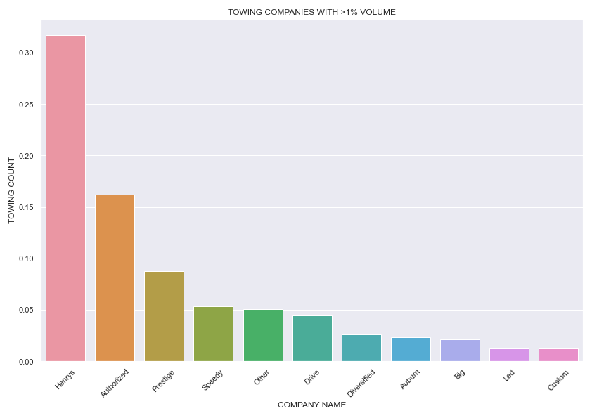
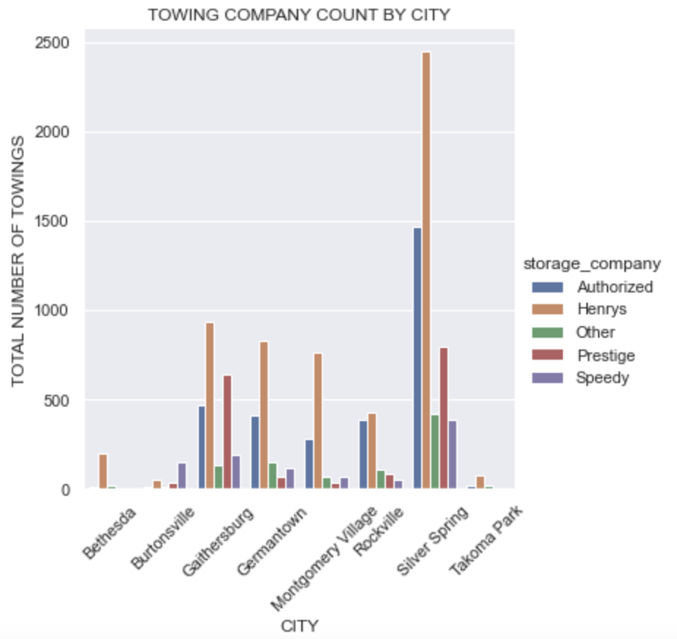
Exploratory data analysis
MOST ACTIVE COMPANIES
COMPANIES MOST ACTIVE IN TOP 8 CITIES

Slide 9
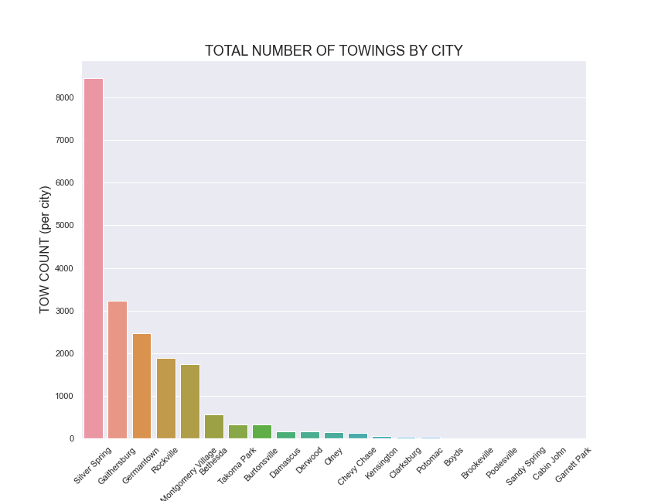
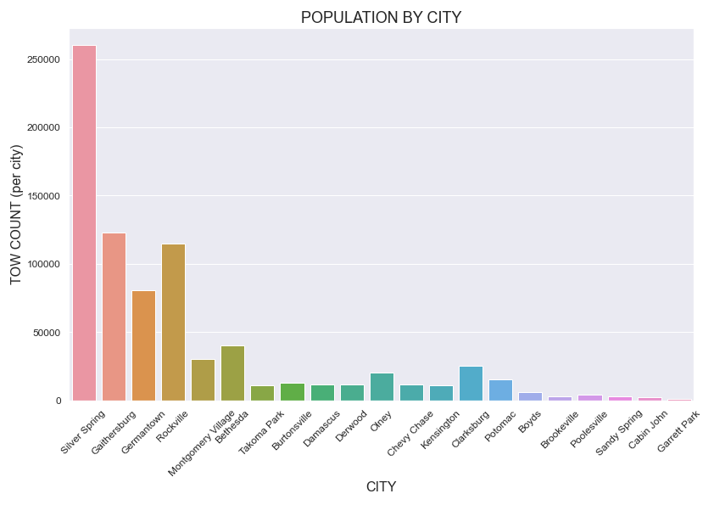
Exploratory data analysis
What city experiences the most towing? It appears Silver Spring does, until we consider populations (summed census blocks) of each.

Slide 10
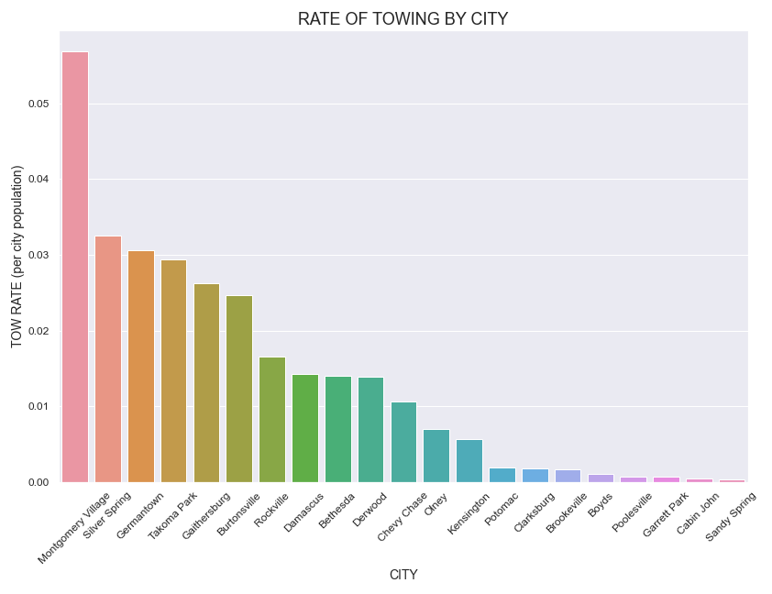
Exploratory data analysis
It turns out Montgomery Village, as a whole, experiences a higher rate of towing.
Statistical comparison of the top 5 cities will be made at the block level to ascertain if towing rates appear to be equitable in blocks of these cities.
Statistical comparison of the top 5 cities, as a group, will be made between them and all others, also as a group.

Slide 11
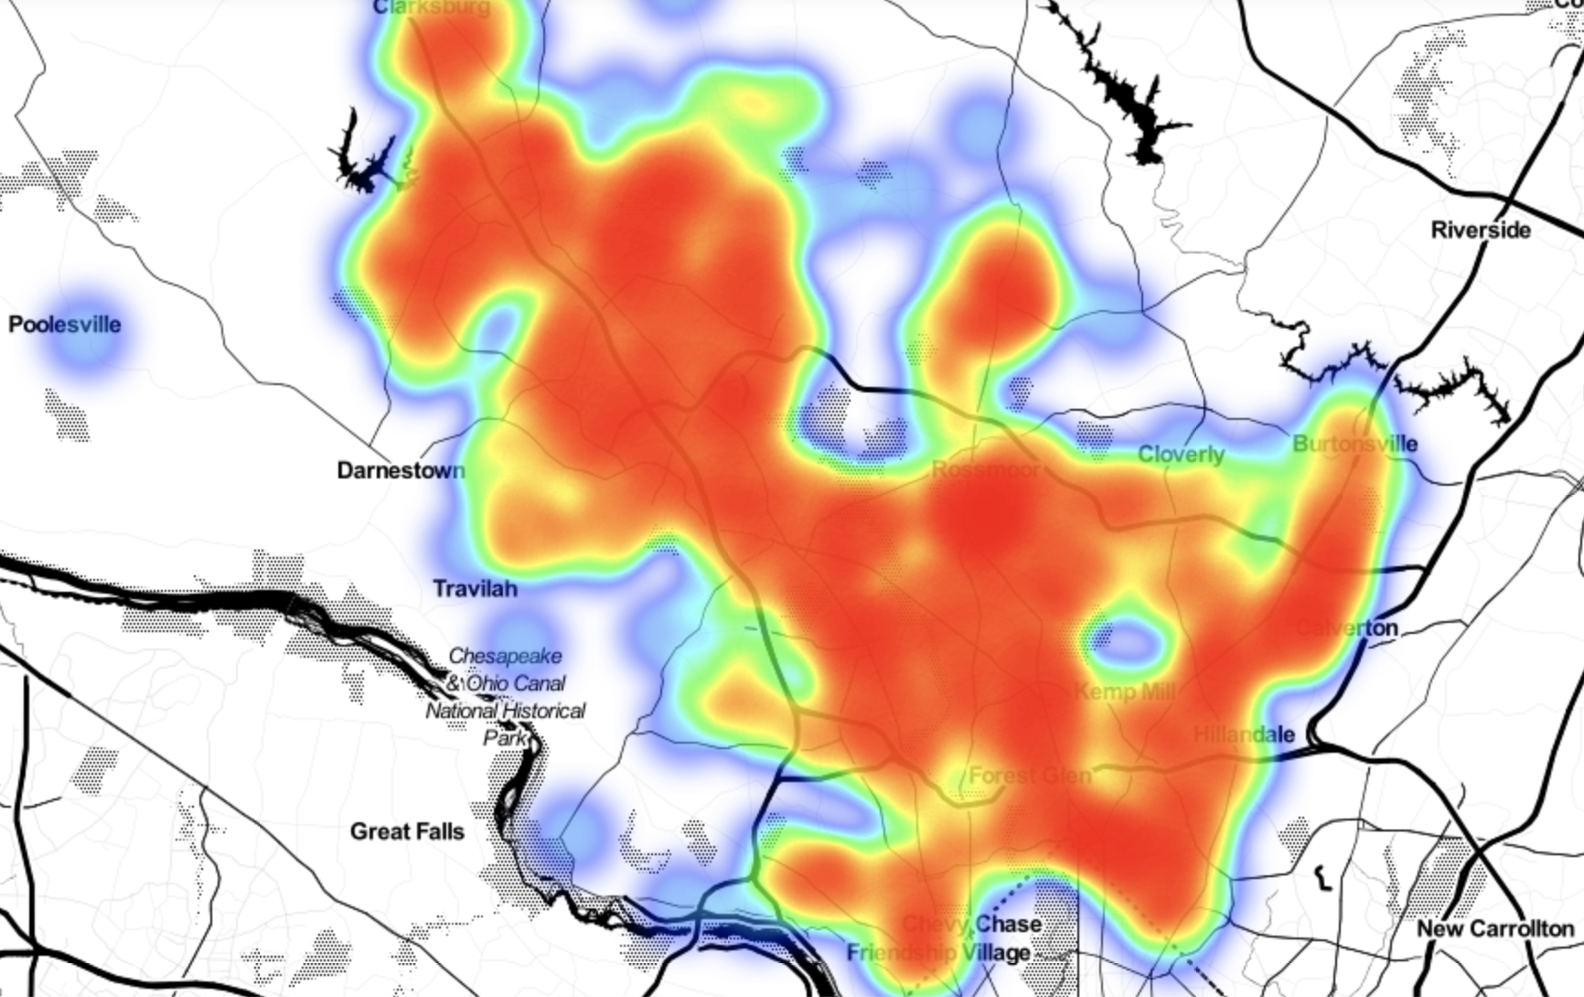
EXPLORATORY DATA ANALYSIS
This is a general heatmap of the county. The cooler colors represent low average towing rates, and the warmer colors represent high average rates.
This map appears to show relatively stable rates across the county for each city; however, block level view does NOT support this view.

Slide 12
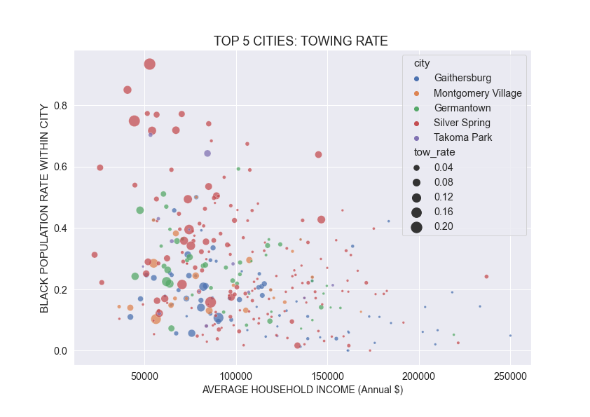
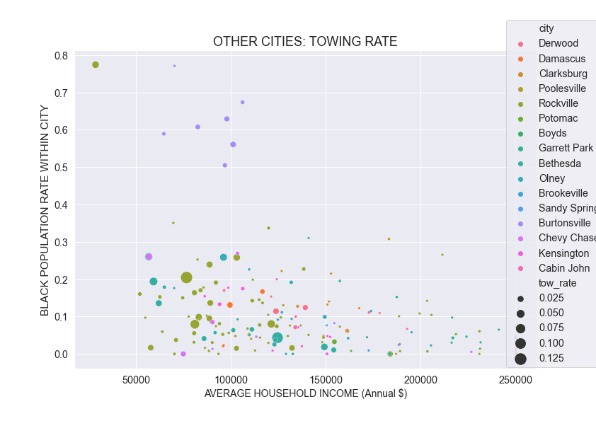
Exploratory data analysis
Note that the tow_rates on the legends indicate different size proportions

Slide 13
Statistical analysis
For comparing the distributions of the Top 5 cities group, I did paired testing of each city to each other city.
Testing was performed using the Wilcoxon-Mann-Whitney test, a nonparametric test(due to non-normality, using Shapiro-Wilkes test):
H_0: Distributions between the two cities’ tow rates are the same
H_alpha: Distributions between the two cities’ tow rates are different
Results: With alpha=0.05, we cannot reject the null for the Gaithersburg-Takoma Park-Silver Spring combinations (p>0.05 ) and the Montgomery Village-Germantown pairings, so distributions may not be different; all other pairings between the Top 5 cities group have p<=0.05; therefore, all others appear to have significantly different distributions of towing rates.
I also compared the aggregated Top 5 cities and Other cities groups: p<=0.05, so we reject the null there as well and find significantly different distributions.

Slide 14
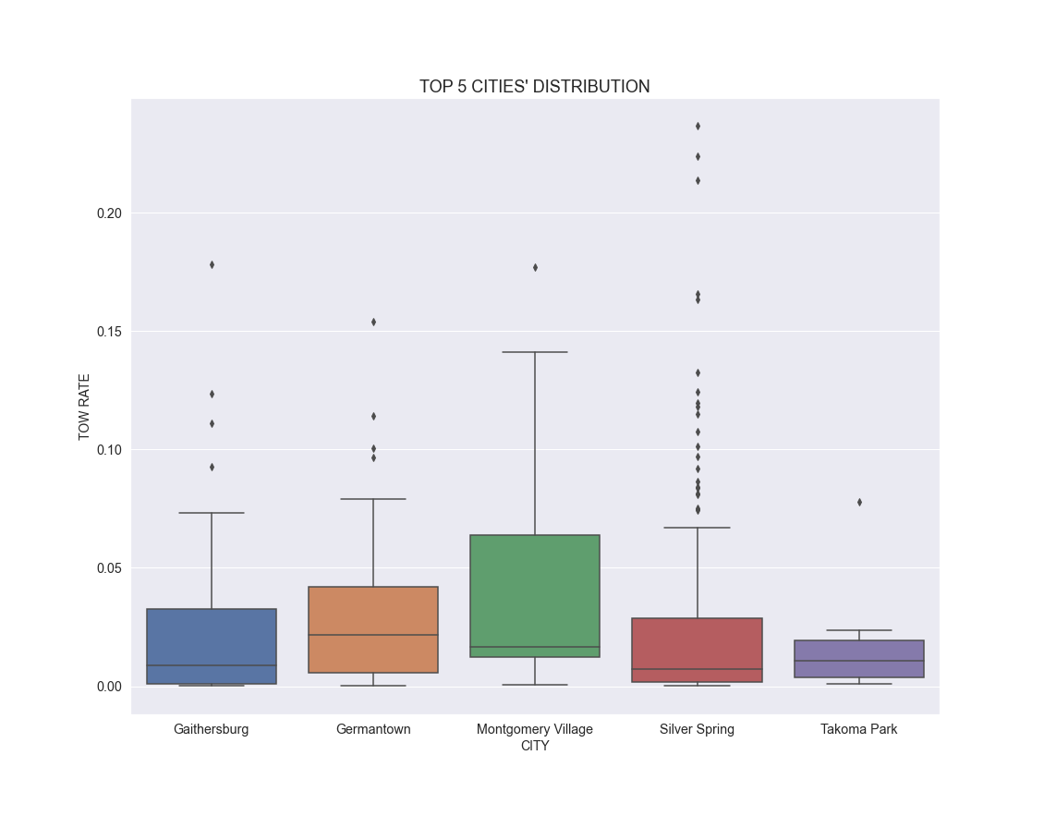
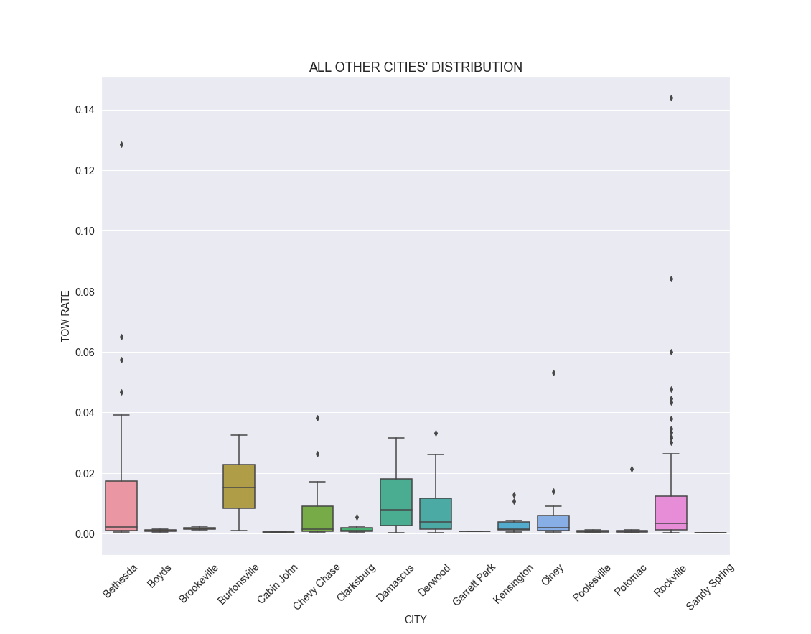
Statistical analysis (visualization of distributionS)
The Wilcoxon-Mann-Whitney test may be compared to these charts. Outliers will be considered next.

Slide 15
Statistical analysis
Generally, outliers may or may not be excluded, but in this case, outliers represent the very area of interest: people that may not be experiencing fair treatment. This is especially true in the case of extreme outliers.
Two methods were used to calculate a cutoff value for tow rate outliers:
Upper fence was calculated using 1.5 x IQR added to the 3rd quartile cutoff.
Generalized Extreme Test for Outliers* (Grubb/Rosner): this test gives us cutoff values for extreme outliers which are usually wider than the IQR fences. The cutoff was calculated to be 0.0919.
*https://github.com/bhattbhavesh91/outlier-detection-grubbs-test-and-generalized-esd-test-python

Slide 16
STATISTICAL ANALYSIS Logistic Regression
FEATURES:
TARGET:
CLASSES:
Household income
Black Population Proportion
0 | no-risk
1 | at-risk
Towing Rate
Accuracy | Precision | Recall | ROC Score
73% | - | - | 87%
Imbalanced:
Accuracy | Precision | Recall | ROC Score
78% | 36% | 92% | 87%
Balanced:
CONCLUSION: The balance gave very good recall so it’s better at catching the at-risk properties; these two features appear to be good enough for this purpose.

Slide 17
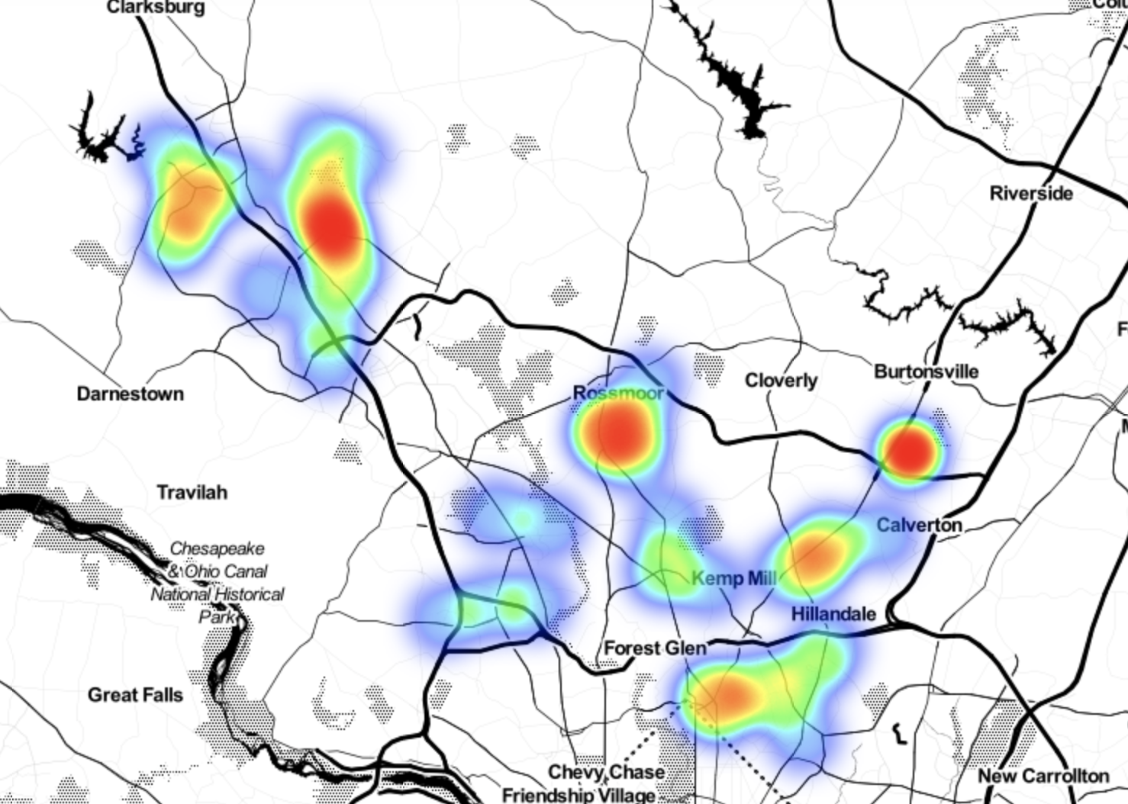
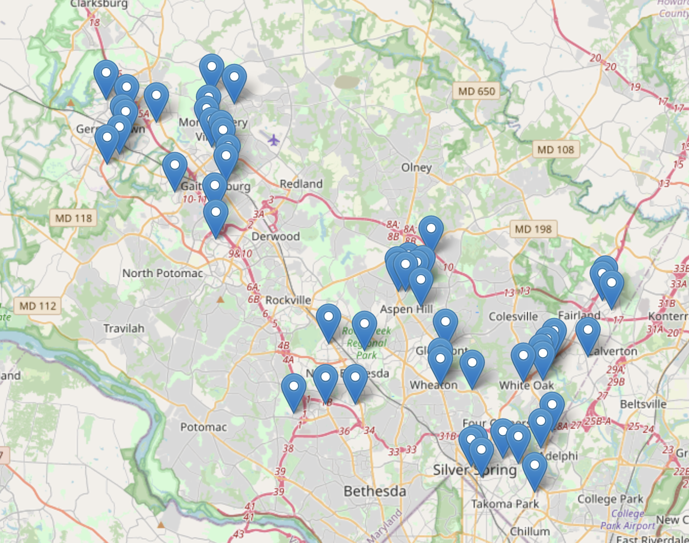
FINAL DATA PRODUCTS
Outliers: above upper fence = 6.0%
Drilling down to census block level, we can mark properties experiencing excessive towing.
*percentage is for the entire block area; marker is pointing at the property with the highest rate within the block

Slide 18
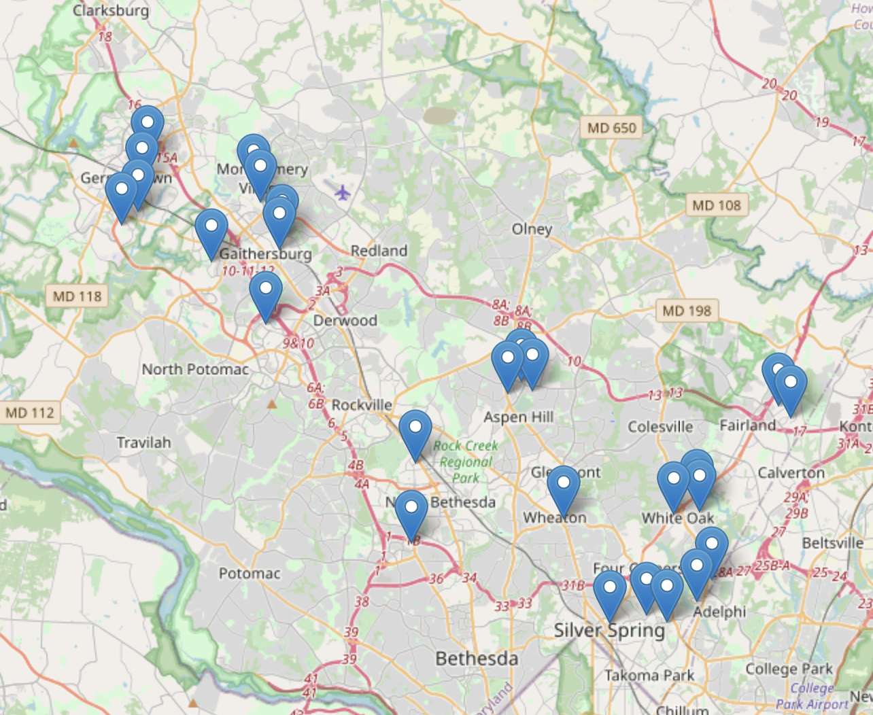
FINAL DATA PRODUCTS
Extreme Outliers: >= 9.2%
These properties are at the extremes of towing rates in the County.
click-to-view
-tooltip for checking towing rate, proportion of population that is black and household income.
-zooming in on markers.
*percentage is for the entire block area; marker is pointing at the property with the highest rate within the block

Slide 19
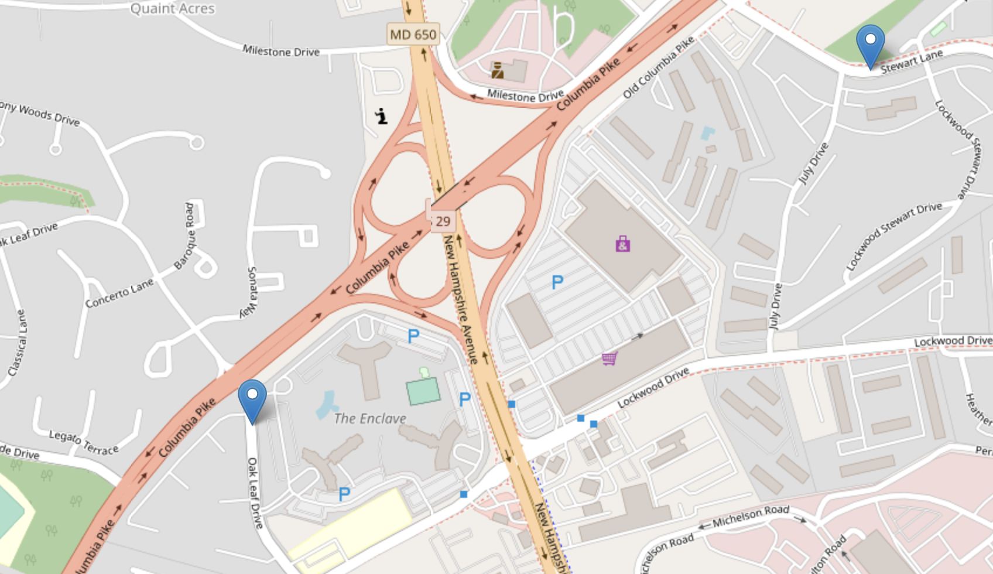
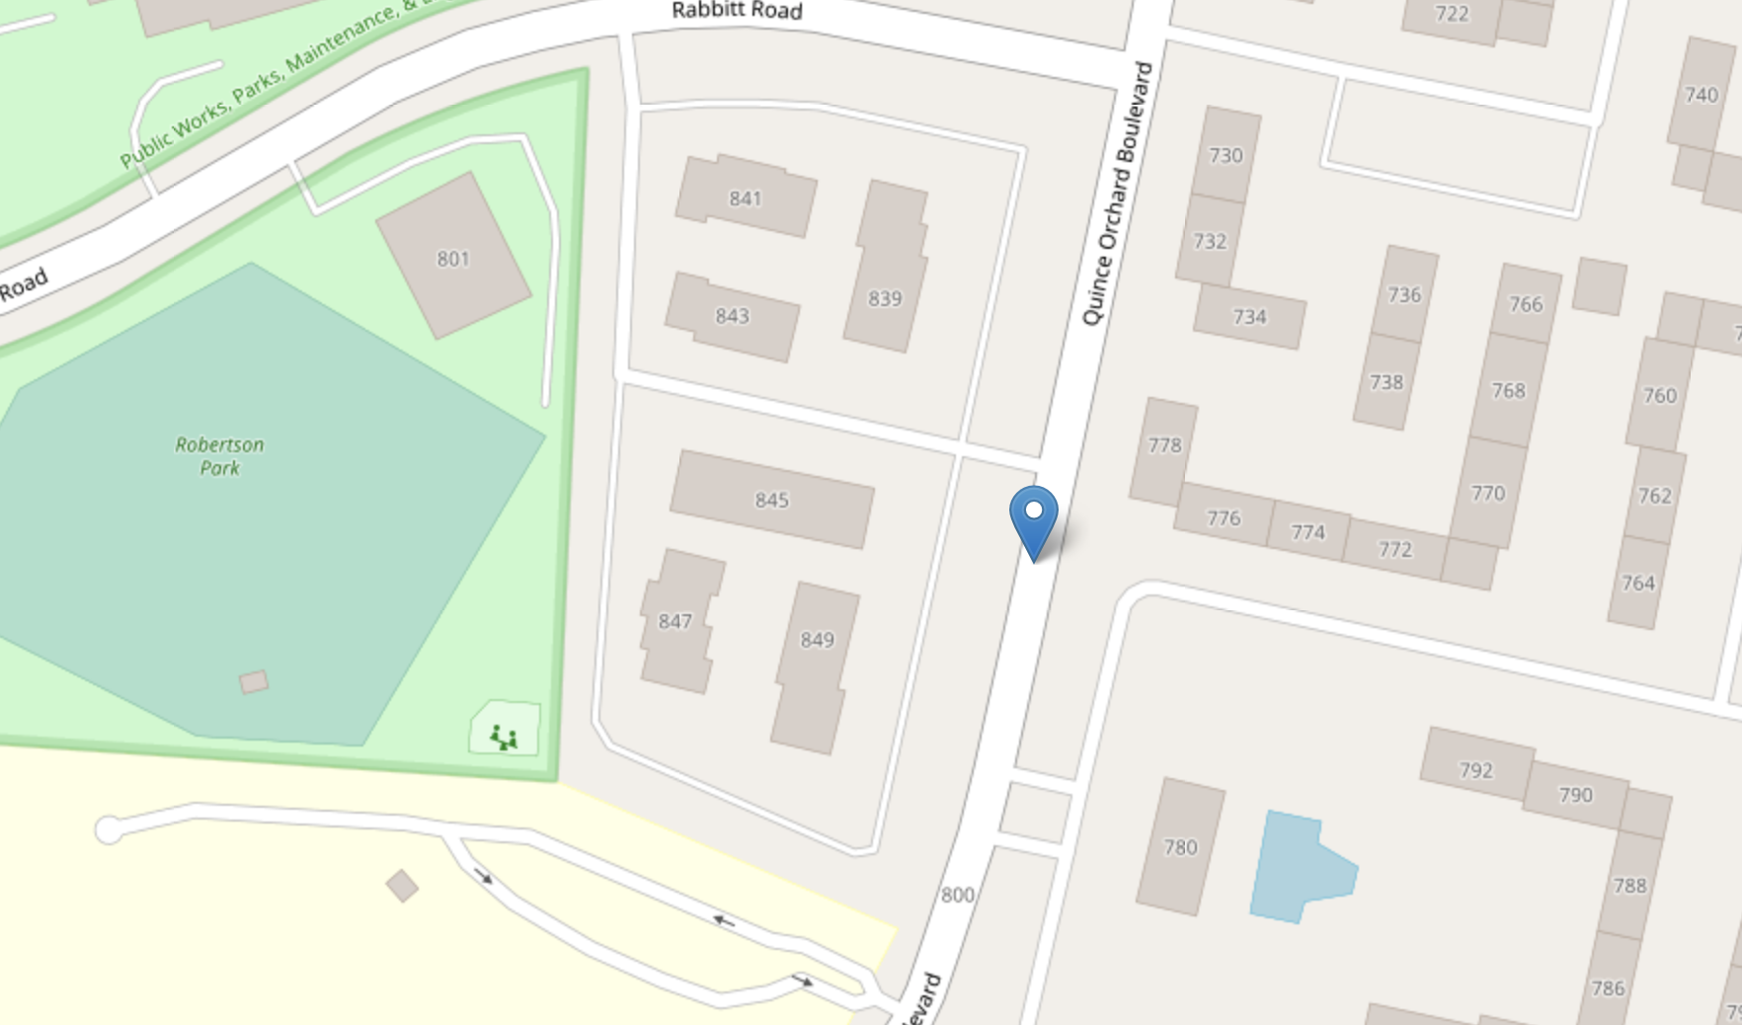
FINAL DATA PRODUCTS
ZOOM IN: 3 blocks with markers GESD(>=9.19% ) for outliers
The blocks on the left are in Silver Spring with towing 22% * and 12%* I should mention that
the one on the right, in Gaithersburg, is where my son lives, at 11.1%*.
*percentage is for the entire block area; marker is pointing at the property with the highest rate within the block

Slide 20
RECOMMENDATIONS
Data Entry: incorporating spellcheck or a choice menu for names would improve data quality.
Montgomery County could use the dataMontgomery website to investigate properties experiencing excessive towing using the map produced here. Even easier, filtering by location(street address) and then storage company columns on dataMontgomery already returns the greatest to least counts of tows, so at-risk properties would be very easy to locate.
Consider policy and towing law, particularly contract towing in apartment and condominium developments. Change the law to be more tenant friendly because some of our most financially vulnerable citizens are experiencing the cost and added stress of the practice as it stands. We must also be on guard against systemic racism in these practices.

Slide 21
Special Thanks to:
Professor Michael Iapalucci
Professor Abdirisak Mohamed
Professor Rachel Saidi
Professor Celia Evans
Ms. Victoria Lewis
Mr. Hudson Finch-Baptiste

Slide 22
THANK YOU FOR ATTENDING THIS PRESENTATION

